Slide 1
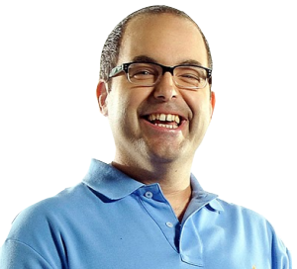

Windows PowerShell DSC Implementation Tips
Timothy Warner
@TechTrainerTim

Slide 2


Why I like Philadelphia

Slide 3
Agenda
Set the stage for our discussion
Review several DSC suggested focus areas
Provide you with takeaways
Say "See ya later!"

Slide 4
Session Materials
http://timw.info/phillyposh

Slide 5
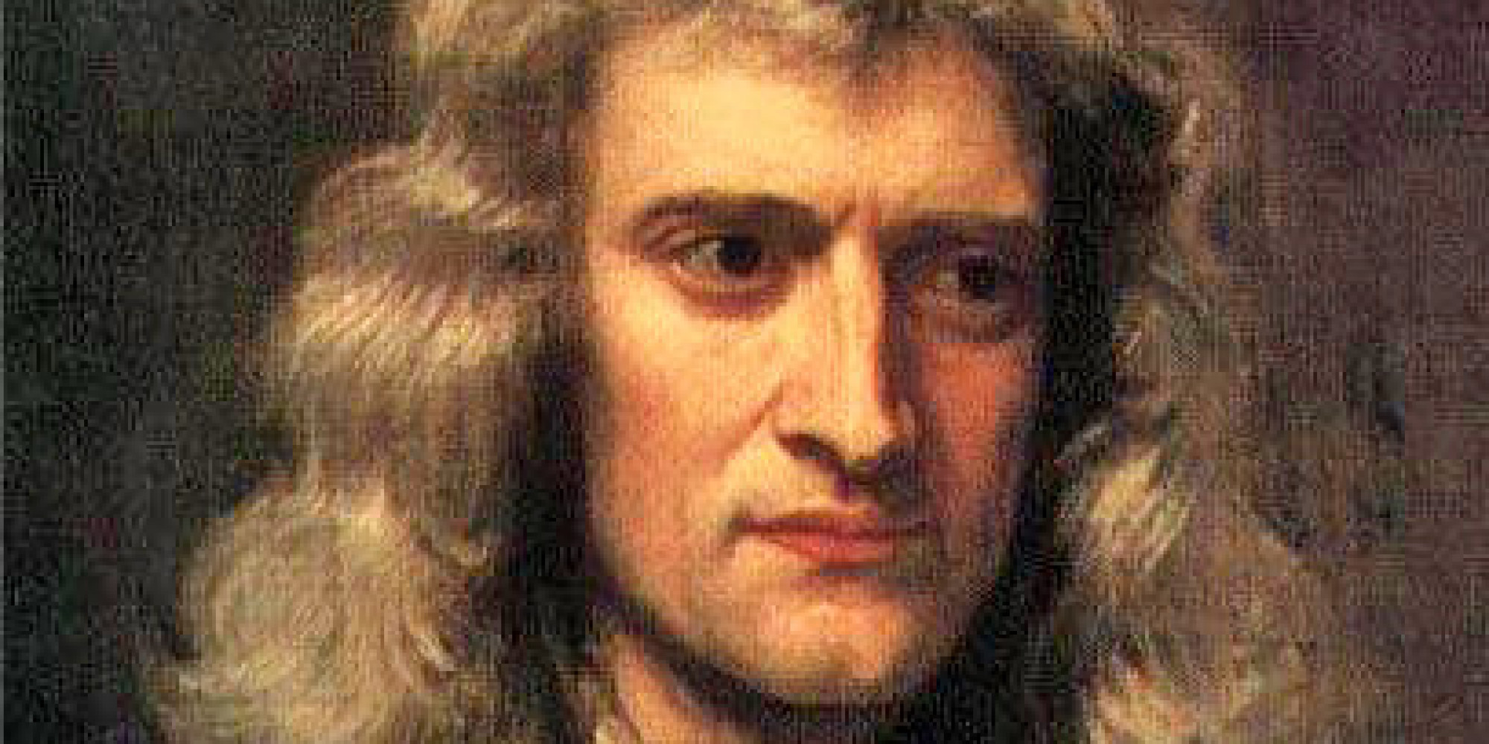
Sir Isaac Newton (1642-1726)
"If I have seen further, it is only by standing on the shoulders of giants."

Slide 6

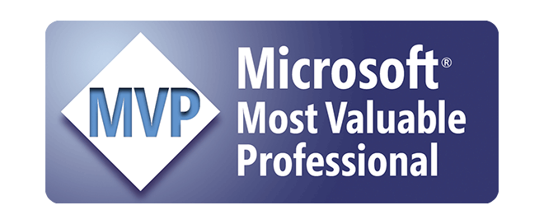
Some PowerShell Giants
Don Jones (@ConcentratedDon)
Jason Helmick (@TheJasonHelmick)
Jeff Hicks (@jeffhicks)
Adam Bertram (@adbertram)
Steve Murawski (@StevenMurawski)
Warren Frame (@psCookieMonster)

Slide 7
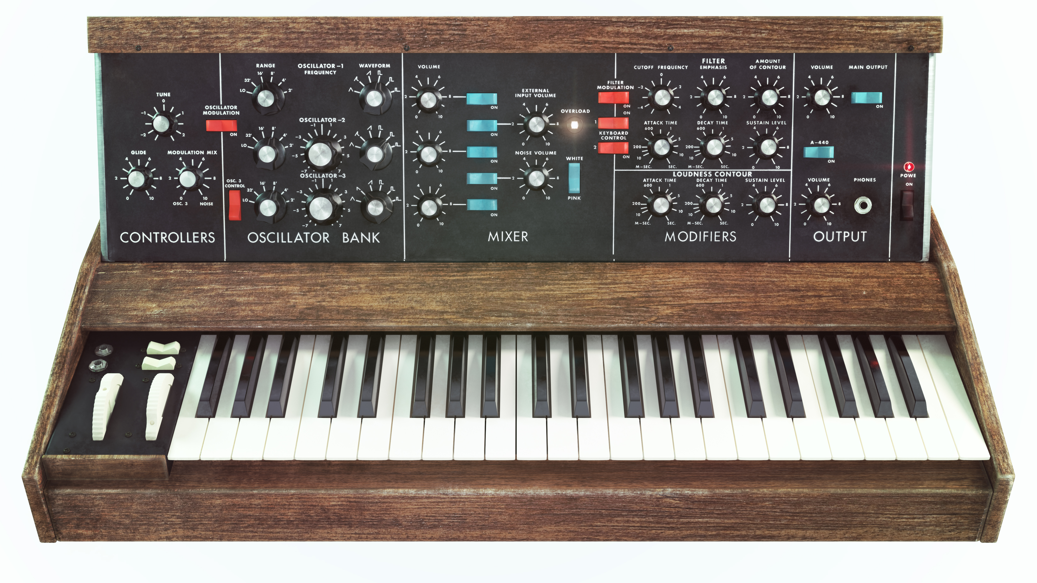
I'm a (data) synthesizer.

Slide 8
The timing, it is suspect...
Big DSC news coming up from the @PowerShell_Team
DSC pull servers are a mess
Azure Automation DSC works well
NDA info
DSC is being overhauled (again)

Slide 9
The Problem

Slide 10
Configuration drift
Inconsistent server configuration due to (a) continual hardware and software changes; and/or (b) missing or ineffective change management processes

Slide 11


Configuration Drift Ramifications
High availability and disaster recovery failures
Southwest Airlines
Compliance audit failures
Reduced performance
Reduced security
Reduced availability
SLA impacts
High cost of manual labor

Slide 12
A Solution

Slide 13

Configuration Management (CM)
Systematic control of hardware and software changes.

Slide 14
DSC Quick Review

Slide 15

Common Information Model (CIM)
DMTF Open Standard
Defines managed hardware and software
Managed Object Format (MOF)
Windows Management Instrumentation (WMI)
Microsoft's CIM implementation
There's only one repository!
Windows PowerShell
Old WMI commands (Get-WMIObject)
New CIM commands (Get-CIMInstance)

Slide 16
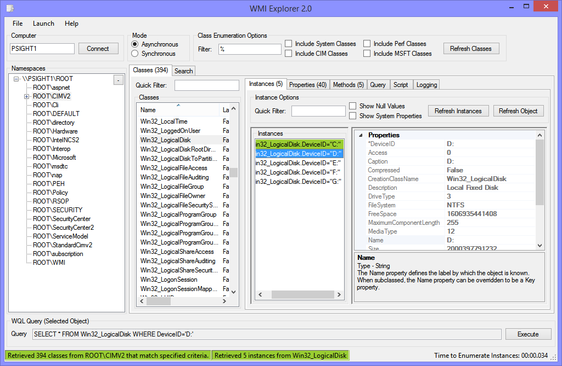

CIM/WMI Repository
http://timw.info/wmie

Slide 17
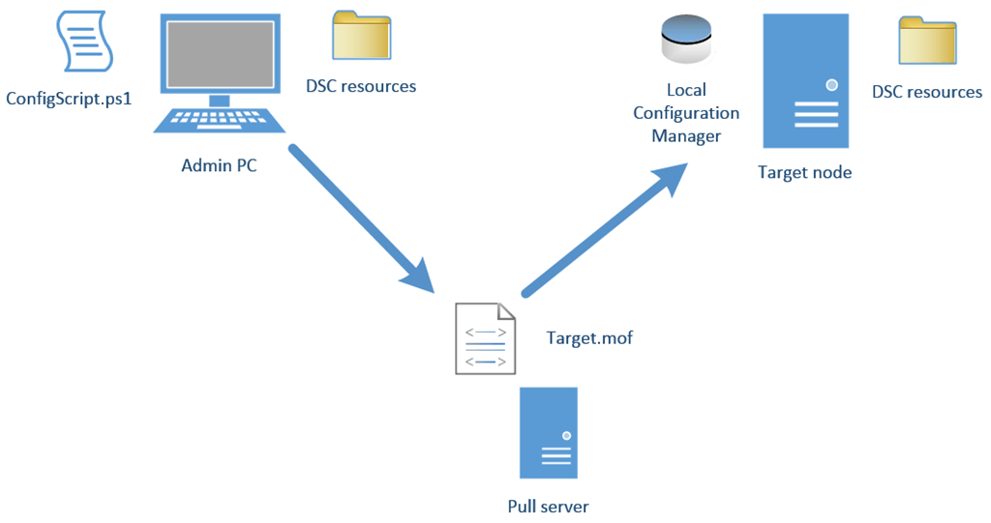
DSC High-Level Architecture
The goal of a DSC configuration is producing a MOF file - you don't need to use Windows PowerShell
WMF v4
WMF v5
HTTP
HTTPS
SMB
Azure Automation DSC

Slide 18
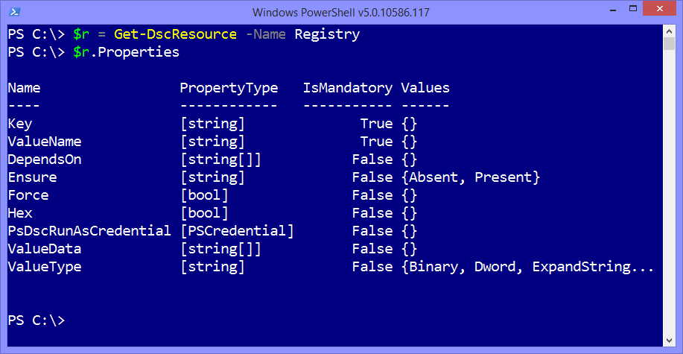

DSC Resources
Building blocks of a DSC configuration
They're PowerShell modules
1 configuration per machine
Avoid partial configurations
Built-in
Experimental (x resources)
Community (c resources)

Slide 19
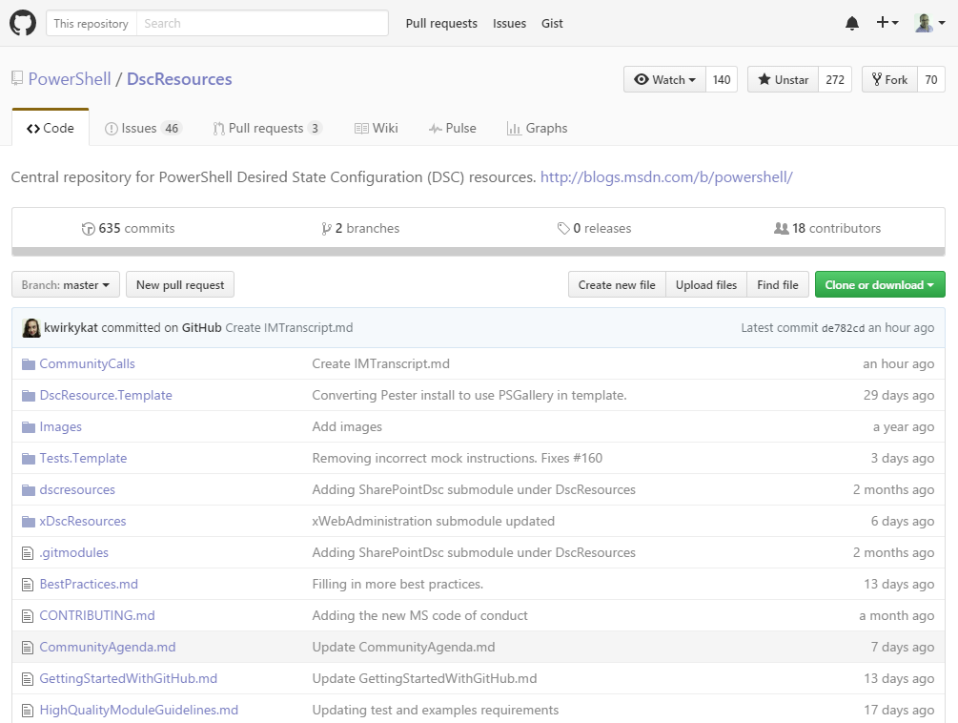
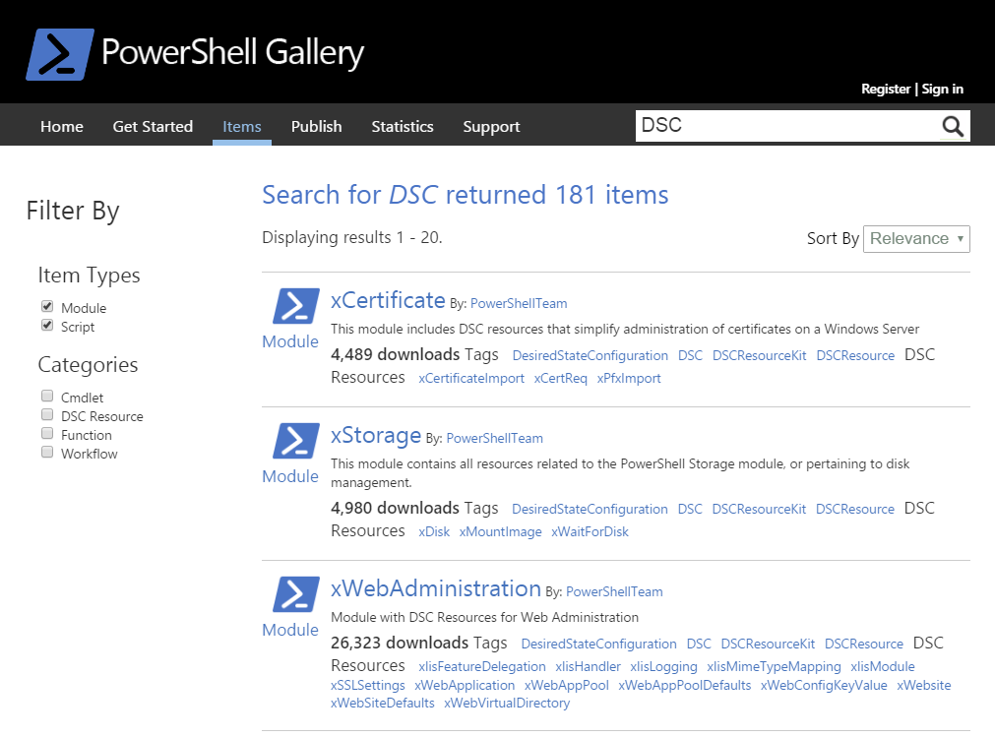
Where to find DSC resources
Install-Module -Name xSharePoint

Slide 20
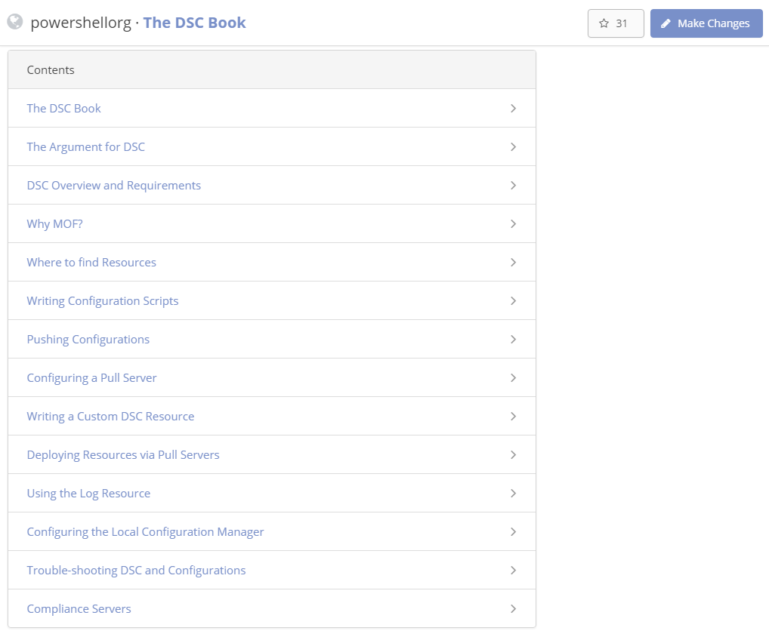
The DSC Book
http://timw.info/dscbook

Slide 21
Focus: Wrap DSC in Another Tool

Slide 22

Windows PowerShell DSC is a CM engine

Slide 23
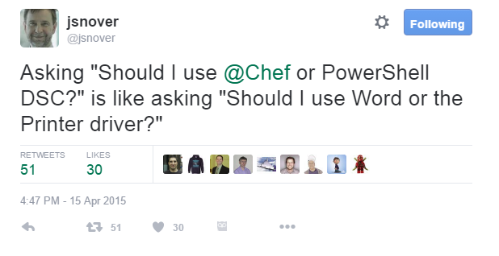
Windows PowerShell DSC is a CM engine

Slide 24






Configuration Management Solutions

Slide 25


Chef...
...can make use of DSC resources
...has rich reporting and auditing
...offers lots of options for administrative tooling
...is integrated natively in the Microsoft Azure portal
Automating Windows PowerShell DSC with Chef (video)
timw.info/chefdsc

Slide 26
Focus: Write Quality Configuration Scripts

Slide 27
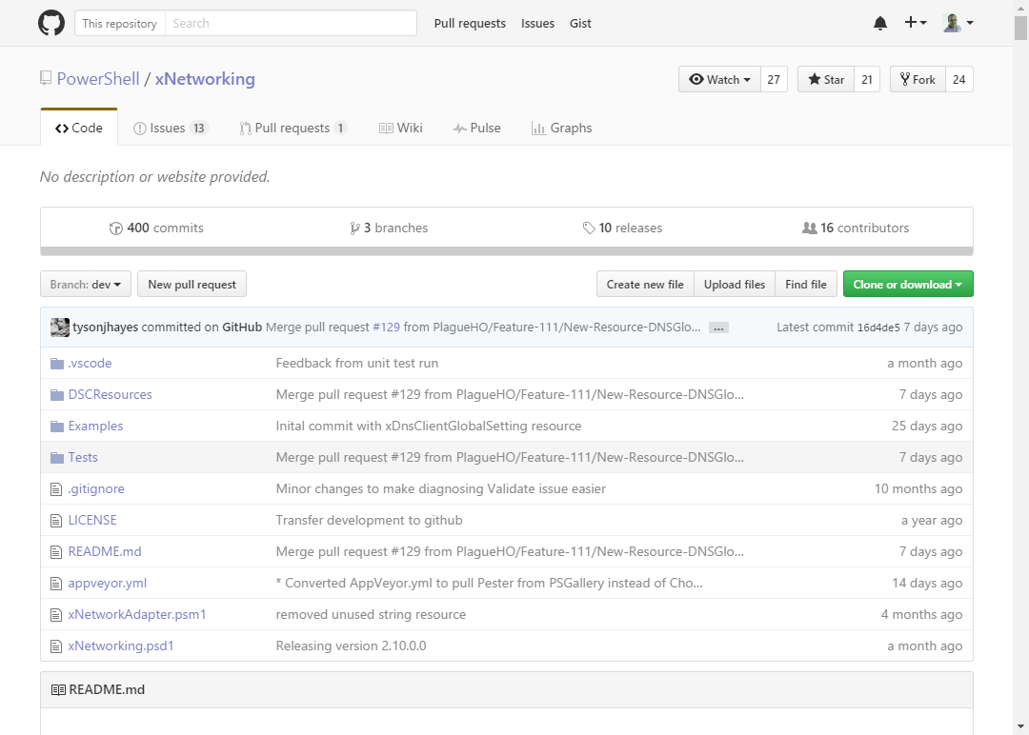
Understand DSC resource structure

Slide 28
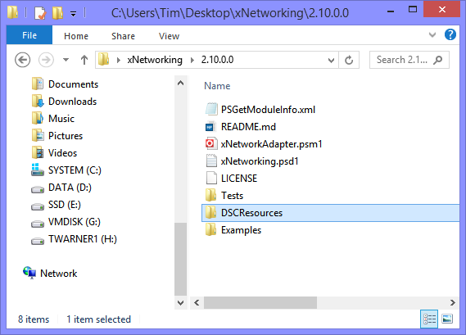
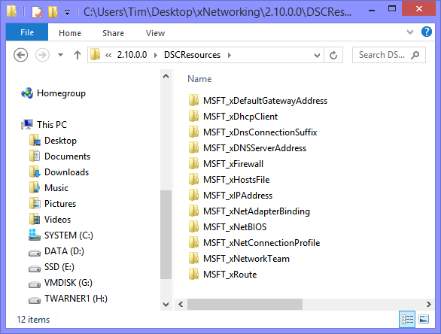
Understand DSC resource structure
Find-Module -Tag DSC
Save-Module -Name xNetworking -Path ~\Desktop
Install-Module -Name xNetworking -Force

Slide 29
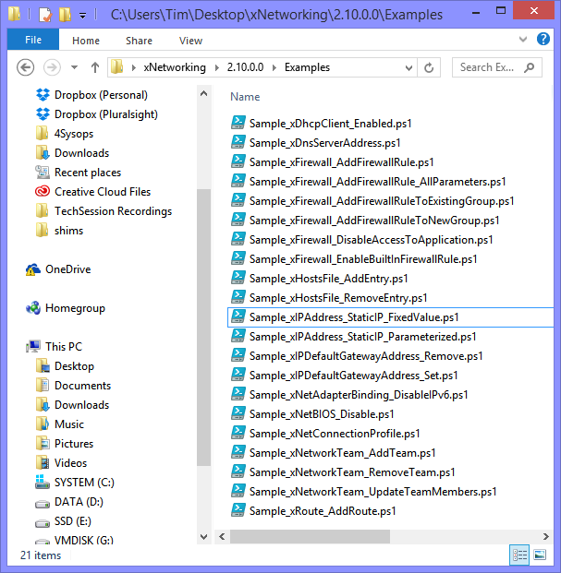
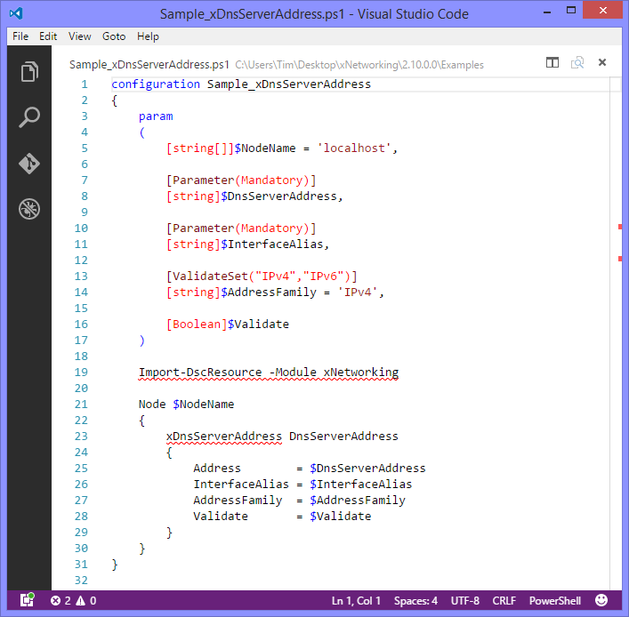
Understand DSC resource structure
Start-DSCConfiguration -Path .\config
Remove-DSCConfigurationDocument -Stage Current

Slide 30
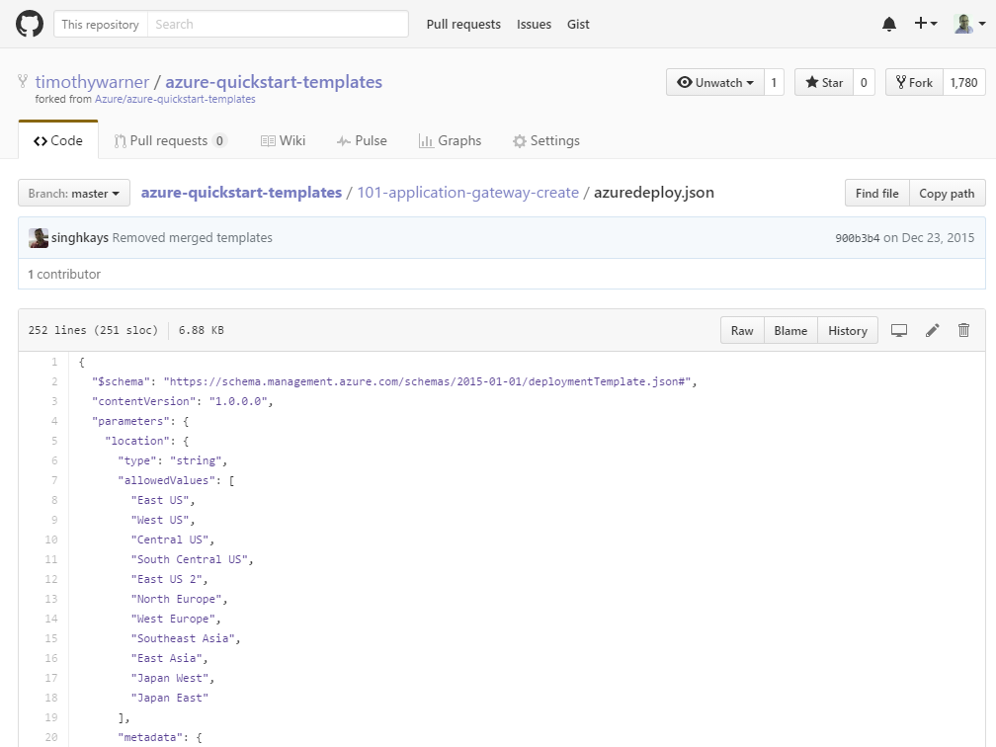
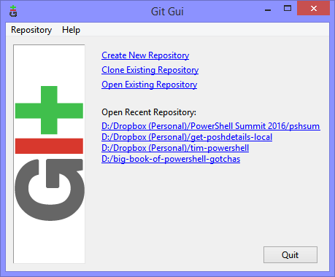
Source Control
Maintainability

Slide 31

Testing - Pester
Unit testing - function level
Test-driven development (TDD)
Look for 100 percent code coverage
Behavior-driven development (BDD)
Methodology for writing good tests that don't require editing every time a function changes
Pester is a BDD framework
Dave Wyatt (@MSH_Dave)

Slide 32
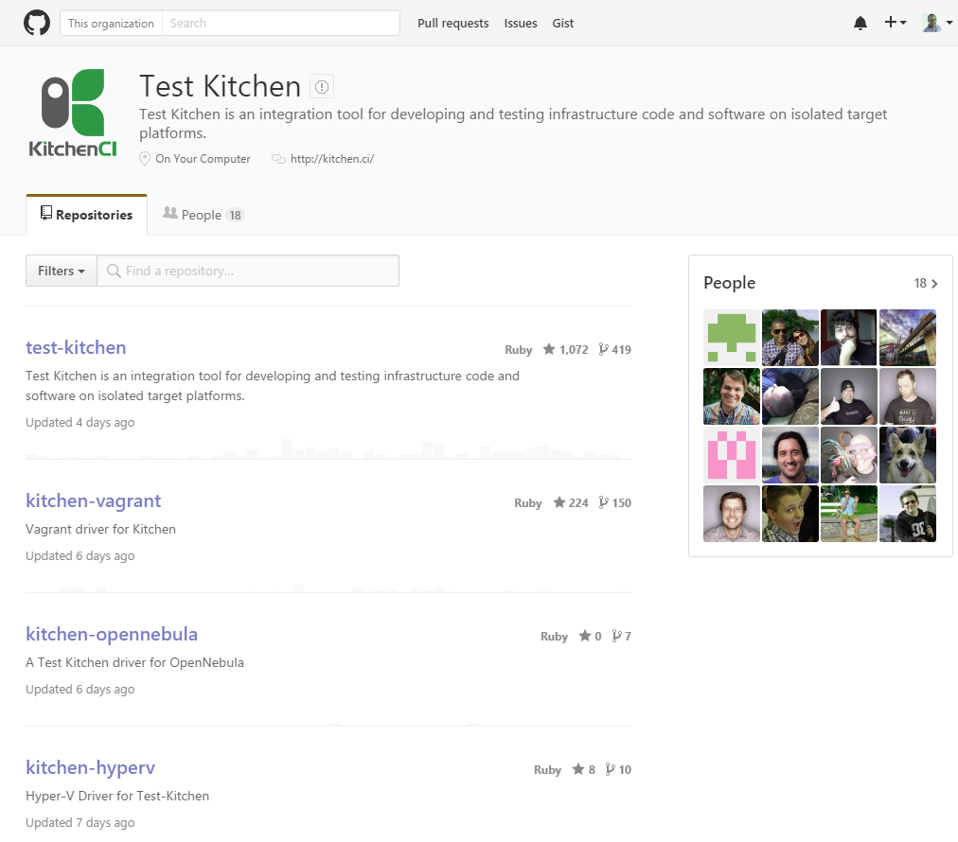
Testing - Test Kitchen
kitchen.ci
Testing automation framework

Slide 33
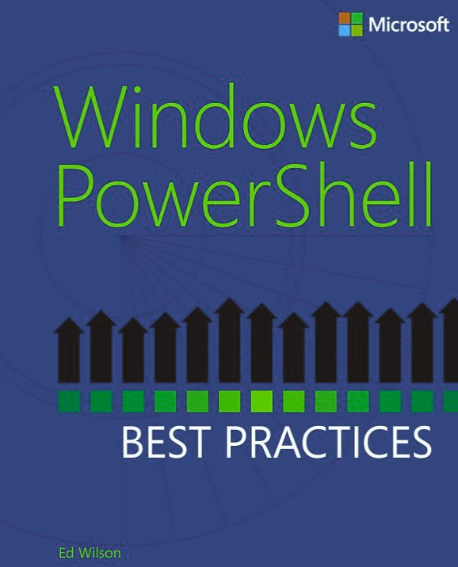
Scripting Best Practices (Meta list)
PowerShell Best Practices and Style Guide (http://timw.info/4ABZ)
Big Book of PowerShell Gotchas (http://timw.info/gotchas)
Brien Posey's BP (http://timw.info/4AC0)
The Top Ten PowerShell Best Practices for IT Pros (http://timw.info/4AC1)
TechNet list (http://timw.info/4AC2)

Slide 34
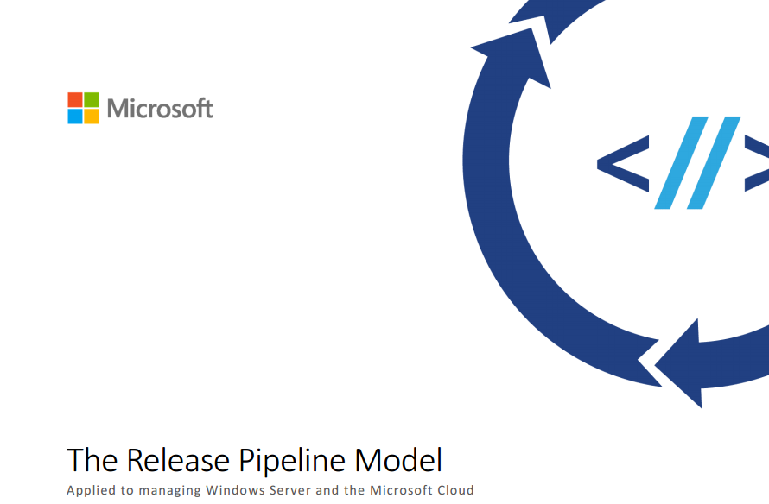
A key whitepaper
http://timw.info/pipeline
Steve Murawski (@StevenMurawski)
Michael Greene (@migreene)

Slide 35
Focus: Master the LCM

Slide 36
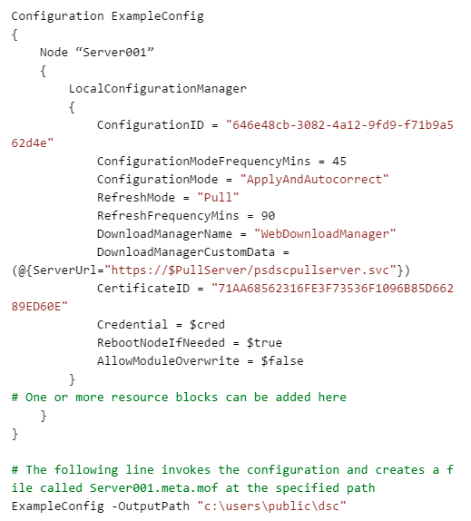
LCM configuration in WMF 4
hostname.mof
hostname.meta.mof

Slide 37
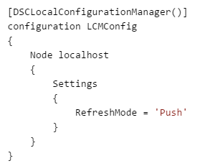
LCM configuration in WMF 5
Set-DscLocalConfigurationManager -Path 'D:\configs\'

Slide 38
Focus: Tread Lightly with Pull Server

Slide 39
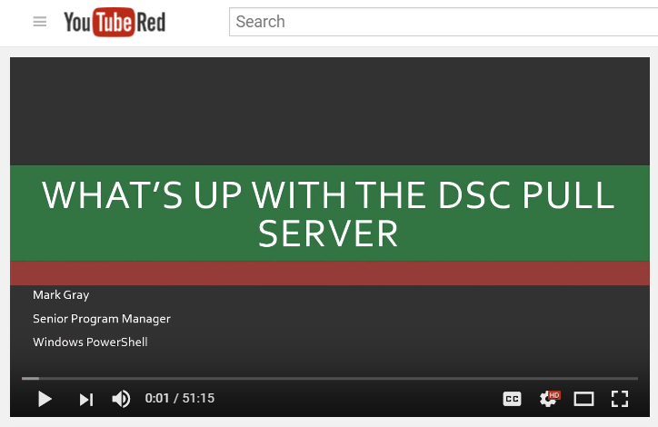
A worthwhile one-hour investment
http://timw.info/whatsup

Slide 40
Focus: Protect Credentials

Slide 41
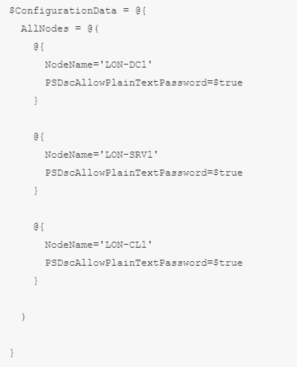
The usual way

Slide 42
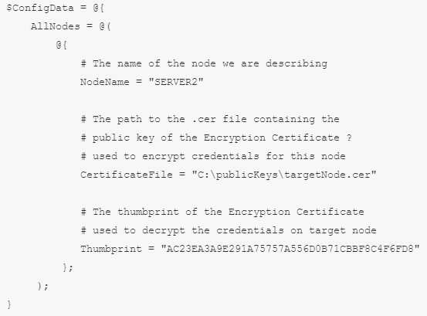
The preferred approach - certificates
Encrypt credentials
Support HTTPS pull server
AD CS PKI

Slide 43
Focus: Write Quality DSC Resources

Slide 44
DSC Resource-related...*ahem* resources
DSC Resource Source Code (http://timw.info/4ABY)
PowerShell Team Blog - DSC Posts (http://timw.info/4ABX)
PowerShell DSC Resource Design and Testing Checklist (http://timw.info/4ABV)
Resource Designer Tool Walkthrough (http://timw.info/4ABW)

Slide 45
Thank You
https://timw.info/phillyposh
timwarnertech.com
@TechTrainerTim

